Slide 1
Projection 변환 행렬

Slide 2
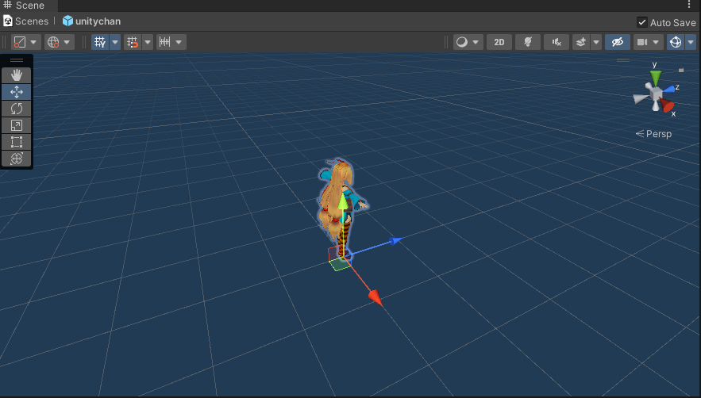
Local space
Up
Look
Right

Slide 3
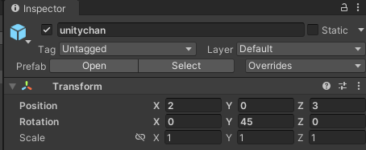
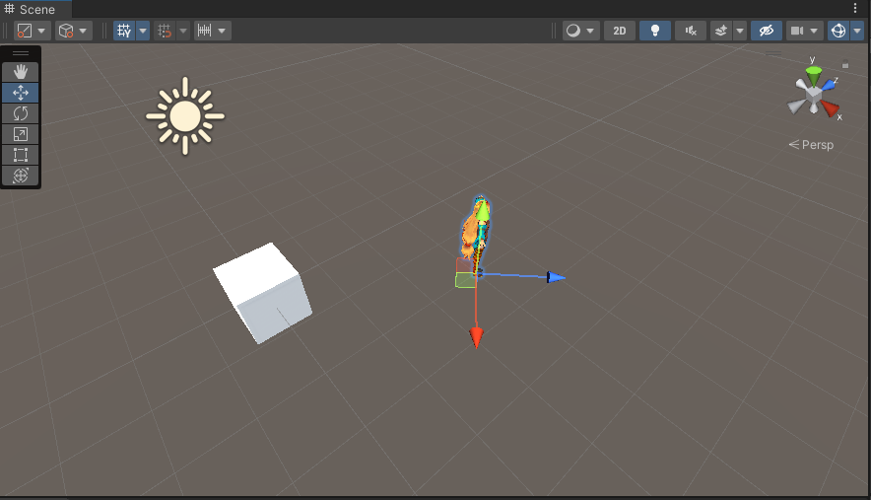
world space
Up
Look
3
2
Right

Slide 4
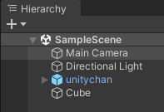
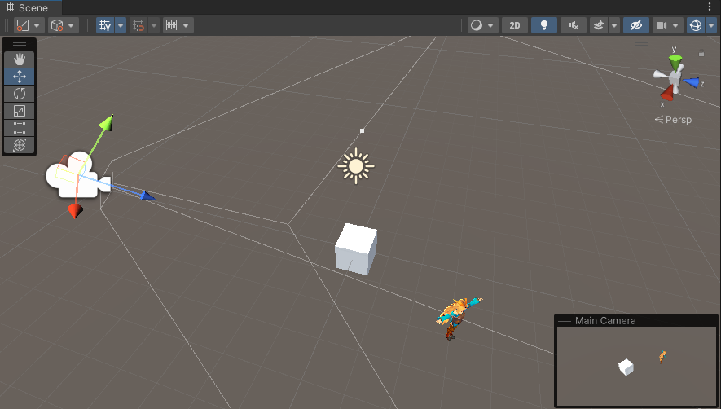
view (camera, eye) space

Slide 5
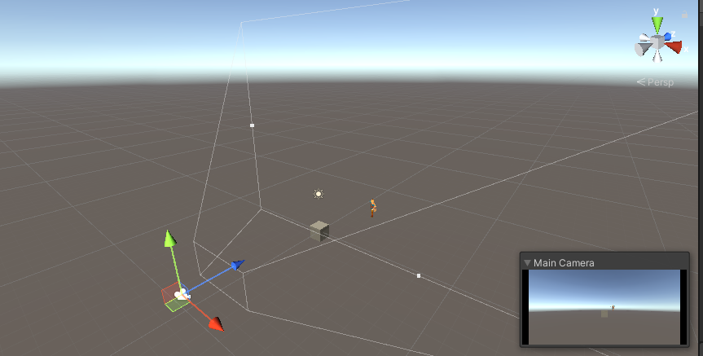
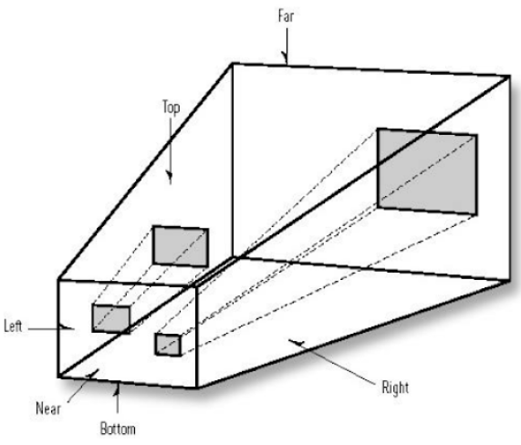
projection space (homogenous clip space)

Slide 6


projection matrix
$$P$$
$$P^{−1}$$

Slide 7
y
y
1
1
x
-1
1
1
z
n
f
1
-1

Slide 8
y
y
1
1
x
-1
1
1
z
n
f
1
-1

Slide 9

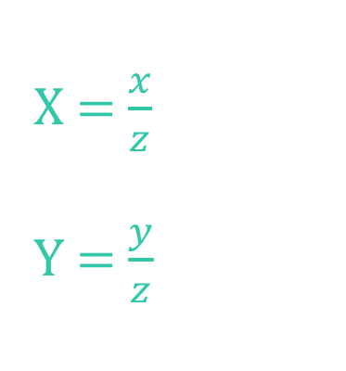
y
$$\vec{v}=\left(x, y, z\right)$$
X = $\frac{x}{z}$
Y = $\frac{y}{z}$
1
1
z
n
f
1

Slide 10
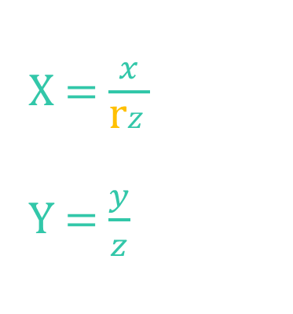

y
$$\vec{v}=\left(x, y, z\right)$$
X = $\frac{x}{\text{r}z}$
Y = $\frac{y}{z}$
1
1
r = $\frac{w}{h}$= $\frac{800}{600}$ = 1.3
z
n
f
1

Slide 11



y
$$\vec{v}=\left(x, y, z\right)$$
X = $\frac{x}{\text{r}ztan⁡(\frac{α}{2}) }$
Y = $\frac{y}{ztan⁡(\frac{α}{2})}$
$$tan⁡(\frac{α}{2})$$
$$α$$
1
r = $\frac{w}{h}$= $\frac{800}{600}$ = 1.3
z
n
f

Slide 12


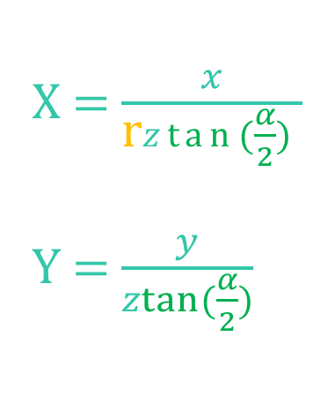
y
X = $\frac{x}{\text{r}ztan⁡(\frac{α}{2}) }$
Y = $\frac{y}{ztan⁡(\frac{α}{2})}$
-1
1
x
-1
M = $\left[\begin{matrix}\begin{matrix}m_{11} & m_{12} \\ m_{21} & m_{22}\end{matrix} & \begin{matrix}m_{13} & m_{14} \\ m_{23} & m_{24}\end{matrix} \\ \begin{matrix}m_{31} & m_{32} \\ m_{41} & m_{42}\end{matrix} & \begin{matrix}m_{33} & m_{34} \\ m_{43} & m_{44}\end{matrix}\end{matrix}\right]$
$$\vec{v}=\left[\begin{matrix}\begin{matrix}x & y & z\end{matrix} & 1\end{matrix}\right]$$
$X= xm_{11}+ym_{21}+zm_{31}$+ $m_{41}$
$$Y= xm_{12}+ym_{22}+zm_{32}\text{+} m_{42}$$

Slide 13

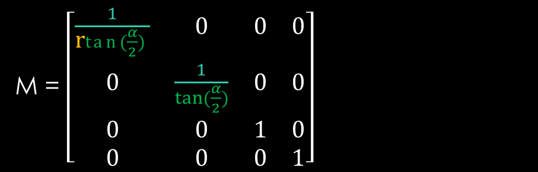
y
X = $\frac{x}{\text{r}ztan⁡(\frac{α}{2}) }$
Y = $\frac{y}{ztan⁡(\frac{α}{2})}$
-1
1
x
-1
M = $\left[\begin{matrix}\frac{1}{\text{r}tan⁡(\frac{α}{2}) } & 0 & 0 & 0 \\ 0 & \frac{1}{tan⁡(\frac{α}{2})} & 0 & 0 \\ 0 & 0 & 1 & 0 \\ 0 & 0 & 0 & 1\end{matrix}\right]$
$$\vec{v}=\left[\begin{matrix}\begin{matrix}x & y & z\end{matrix} & 1\end{matrix}\right]$$
$\vec{V}=$($\frac{x}{\text{r}tan⁡(\frac{α}{2}) }$, $\frac{y}{tan⁡(\frac{α}{2})}$, z, 1)

Slide 14

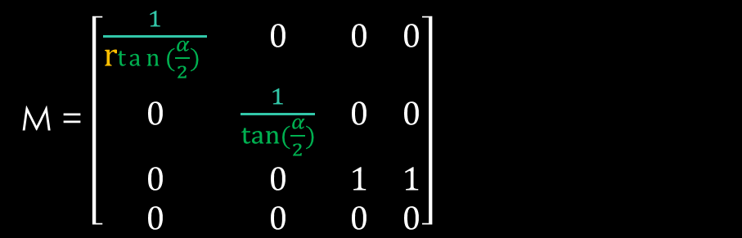
y
X = $\frac{x}{\text{r}ztan⁡(\frac{α}{2}) }$
Y = $\frac{y}{ztan⁡(\frac{α}{2})}$
-1
1
x
-1
M = $\left[\begin{matrix}\frac{1}{\text{r}tan⁡(\frac{α}{2}) } & 0 & 0 & 0 \\ 0 & \frac{1}{tan⁡(\frac{α}{2})} & 0 & 0 \\ 0 & 0 & 1 & 1 \\ 0 & 0 & 0 & 0\end{matrix}\right]$
$$\vec{v}=\left[\begin{matrix}\begin{matrix}x & y & z\end{matrix} & 1\end{matrix}\right]$$
$\vec{V}=$($\frac{x}{\text{r}tan⁡(\frac{α}{2}) }$, $\frac{y}{tan⁡(\frac{α}{2})}$, z, z)

Slide 15


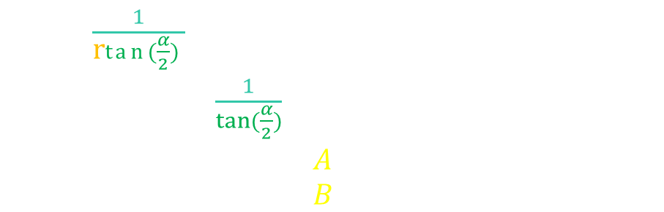


X = $\frac{x}{\text{r}ztan⁡(\frac{α}{2}) }$
Y = $\frac{y}{ztan⁡(\frac{α}{2})}$
$$tan⁡(\frac{α}{2})$$
$$α$$
1
z
n
f
M = $\left[\begin{matrix}\frac{1}{\text{r}tan⁡(\frac{α}{2}) } & 0 & 0 & 0 \\ 0 & \frac{1}{tan⁡(\frac{α}{2})} & 0 & 0 \\ 0 & 0 & A & 1 \\ 0 & 0 & B & 0\end{matrix}\right]$
$$\vec{v}=\left[\begin{matrix}\begin{matrix}x & y & z\end{matrix} & 1\end{matrix}\right]$$
$\vec{V}=$($\frac{x}{\text{r}tan⁡(\frac{α}{2}) }$, $\frac{y}{tan⁡(\frac{α}{2})}$, Az+$B$, z)
$\vec{V′}=$($\frac{x}{\text{r}\text{z}tan⁡(\frac{α}{2}) }$, $\frac{y}{\text{z}tan⁡(\frac{α}{2})}$, A+$\frac{B}{z}$, 1)

Slide 16

X = $\frac{x}{\text{r}ztan⁡(\frac{α}{2}) }$
Y = $\frac{y}{ztan⁡(\frac{α}{2})}$
$$tan⁡(\frac{α}{2})$$
$$α$$
1
z
n
f
M = $\left[\begin{matrix}\frac{1}{\text{r}tan⁡(\frac{α}{2}) } & 0 & 0 & 0 \\ 0 & \frac{1}{tan⁡(\frac{α}{2})} & 0 & 0 \\ 0 & 0 & A & 1 \\ 0 & 0 & B & 0\end{matrix}\right]$
$$\vec{v}=\left[\begin{matrix}\begin{matrix}x & y & z\end{matrix} & 1\end{matrix}\right]$$
A+$\frac{B}{n}$ = 0
A+$\frac{B}{f}$ = 1
$\vec{V}=$($\frac{x}{\text{r}tan⁡(\frac{α}{2}) }$, $\frac{y}{tan⁡(\frac{α}{2})}$, Az+$B$, z)
$\vec{V′}=$($\frac{x}{\text{r}\text{z}tan⁡(\frac{α}{2}) }$, $\frac{y}{\text{z}tan⁡(\frac{α}{2})}$, A+$\frac{B}{z}$, 1)

Slide 17






$\vec{V}=$($\frac{x}{\text{r}tan⁡(\frac{α}{2}) }$, $\frac{y}{tan⁡(\frac{α}{2})}$, Az+$B$, z)
$\vec{V′}=$($\frac{x}{\text{r}\text{z}tan⁡(\frac{α}{2}) }$, $\frac{y}{\text{z}tan⁡(\frac{α}{2})}$, A+$\frac{B}{z}$, 1)
A+$\frac{B}{n}$ = 0
A+$\frac{B}{f}$ = 1
A = $\frac{f}{f−n}$
B = $\frac{−nf}{f−n}$
M = $\left[\begin{matrix}\frac{1}{\text{r}tan⁡(\frac{α}{2}) } & 0 & 0 & 0 \\ 0 & \frac{1}{tan⁡(\frac{α}{2})} & 0 & 0 \\ 0 & 0 & \frac{f}{f−n} & 1 \\ 0 & 0 & \frac{−nf}{f−n} & 0\end{matrix}\right]$
$$\vec{v}=\left[\begin{matrix}\begin{matrix}x & y & z\end{matrix} & 1\end{matrix}\right]$$

